Slide 1

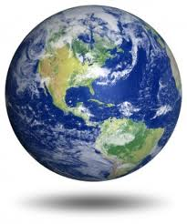
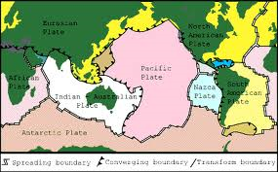
JEOPARDY
Earth’s Interior
and
Plate Tectonics

Slide 2
Directions
Students will be split into 2 teams
Pick one person from each team to be the score keeper and one person to be the spokesman
Each team will alternate picking a category and a point value
Unlike the real Jeopardy where the answer is given, the question will be given and you will have to give the answer
You will have 30 seconds to answer the question
When you have agreed on an answer the appointed person will share it with the class. Please click on the question again to reveal the answer.
If you are correct you get the points. Points will not be deduced for incorrect answers.
Please click on the earth to get back to the game board.
There is one daily double. If you get the question correct you will get double the points it is worth.
The team with the most points at the end of the game will win!
Notes:
Once #1 comes onto the screen divide the class into 2 teams. Make this quick and just divide down the middle of the room. Give the students about 30 seconds to decide who is going to keep score and give the answers. Make sure you let the students know you are going to have a timer set for the 30 second time limit for answering questions and REMEMBER TO USE IT!!!! After the directions have been explained give about 1 minute for questions and toss a coin to decide who will start. Make sure the students understand the importance of taking this game seriously as this is the material that will be tested on in a few days.

Slide 3
And the Categories Are…

Slide 4
Label the
Earth’s Layers

Slide 5
Earth’s Layers

Slide 6
Label the
Plate Tectonic Features

Slide 7
Plate Boundaries

Slide 8
Formations

Slide 9
Label Earth’s Layers | Earth’s Layers | Label the Plate Tectonic Features | Plate Boundaries | Formations
100 | 100 | 100 | 100 | 100
200 | 200 | 200 | 200 | 200
300 | 300 | 300 | 300 | 300
400 | 400 | 400 | 400 | 400
500 | 500 | 500 | 500 | 500

Slide 10
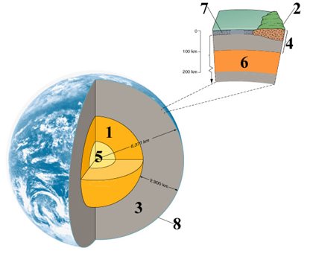

What layer is represented by #1 on the picture below?

Slide 11
What layer is represented by #3 on the picture below?

Slide 12
What layer is represented by #5 on the picture below?

Slide 13
What layer is represented by #8 on the picture below?

Slide 14
What layer is represented by #4 on the picture below?

Slide 15
Outer Core

Slide 16
Mantle

Slide 17
Inner Core

Slide 18
Crust

Slide 19
Lithosphere

Slide 20
The inner core is most likely composed of ?

Slide 21
What is the thinnest layer of Earth?

Slide 22
What do the crust and the upper mantle make up?

Slide 23
Name the boundary that separates the crust from the mantle

Slide 24
Define geophysics

Slide 25
Iron

Slide 26
Lithosphere

Slide 27
The Moho

Slide 28
The Crust

Slide 29
The branch of geology that studies the interior of the Earth from measurements taken on the surface of the Earth

Slide 30
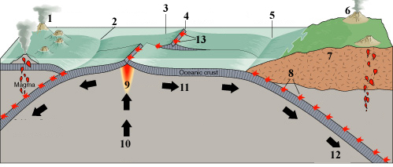
What feature is represented by #1 on the picture below?

Slide 31
What feature is represented by #2 on the picture below?

Slide 32
What feature is represented by #4 on the picture below?

Slide 33
What feature is represented by #5 on the picture below?

Slide 34
What feature is represented by #8 on the picture below?

Slide 35
Volcanic Island Arc

Slide 36
Ocean-Ocean Convergent Boundary

Slide 37
Divergent Plate Boundary

Slide 38
Ocean-Continent Convergent Boundary

Slide 39
Benioff Zone

Slide 40
Tectonic plates are part of Earth’s?

Slide 41
Describe Pangea?

Slide 42
What were the 2 supercontinents of Pangea called?

Slide 43
Who described the theory of continental drift?

Slide 44
Describe the theory of continental drift?

Slide 45
DAILY
DOUBLE

Slide 46
This theory explained that the continents floated on a liquid core and one time were connected to form the supercontinent called Pangea. This eventually broke apart and the continents drifted to their present locations
Click answer to watch a cool video
Notes:
After the students have answered this question proceed to the you tube video. Make sure that the students watch carefully as this video shows how the continents were formed over all the geologic time periods. Leave a few minutes for any questions the students may have come up with after watching the video.

Slide 47
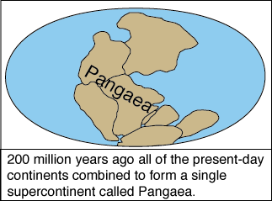
Pangea was a single super continent formed in the past when all the landmasses of the Earth were connected.

Slide 48
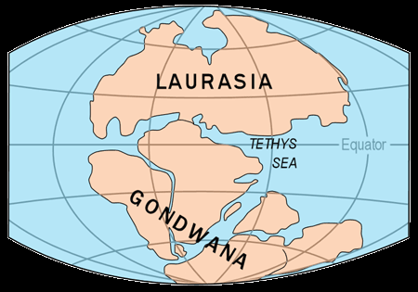
The northern supercontinent was called Laurasia and the southern continent was called Gondwanaland.

Slide 49
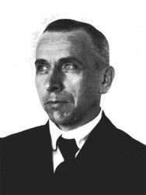
Alfred Wegener

Slide 50
Lithosphere

Slide 51
Name 2 types of geologic events that occur as a result of plate boundary movement

Slide 52
The Hawaiian Islands are a result of what?

Slide 53
The largest magnitude earthquakes are associated with what type of plate boundary?

Slide 54
Name 2 mountain belts we discussed in class.

Slide 55
What features would you expect to find at an ocean-continent convergent boundary?

Slide 56
Volcanic activity, earthquakes, tsunamis

Slide 57
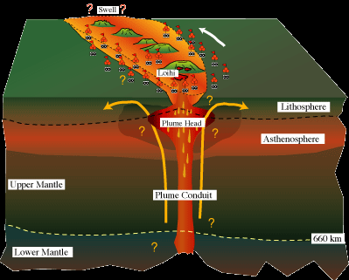
A mantle plume

Slide 58
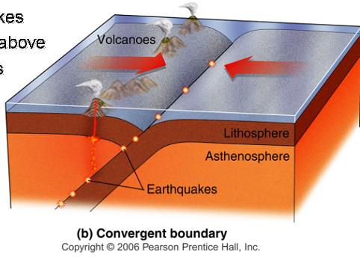
Convergent Plate Boundary

Slide 59
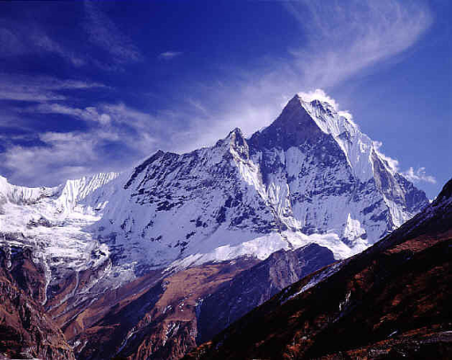
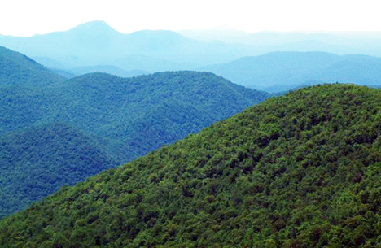
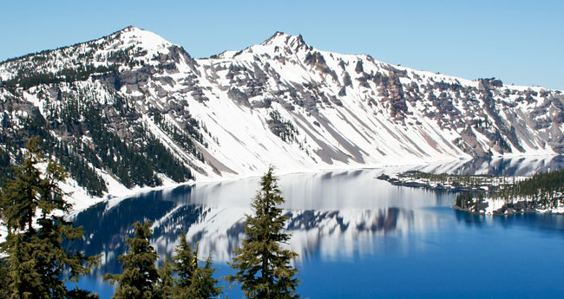
Himalayas, Cascade Range, Appalachians

Slide 60
Earthquakes, deep ocean trenches, and volcanic mountain chain
END OF GAME!!!

Slide 61
AWESOME JOB!!!!
Study hard and you all will do great on your test ☺

